Slide 1



Team
22F-3102 Ammar Akbar
22F-3162 Sameer Khan
22F-3101 Murtaza Mehdi

Slide 2
Project Title:
Unified Intelligent Ecosystem for Automotive Enthusiasts
Supervisor(s):
Ms. Juhinah Batool Asif

Slide 3
Outline
Problem Statement
Motivation
Expected Outcome
Benefits
Impact of Software
Type of Project: Development
Project Scope
High Level Features
Related Projects
High Level System Diagram
Tools/Technologies/Environment
References

Slide 4
Problem Statement
Manual Part Identification Knowledge Gap
Offline Market Fragmented Inventory Scouting
Last-Mile Logistical Void Component Delivery
Prohibitive Professional Performance Hardware Costs
Inefficient Fragmented Auto Event Coordination
Non-Expert Technical Modification Guidance Barrier

Slide 5
Motivation
Automated AI Visual Identification System
Digitized Traditional Market Access Solution
Expert Technical Build Guidance Portal
Accessible Precision Performance Tracking Analytics
Professionalized Community Event Management Infrastructure

Slide 6
Expected Outcome
Functional AI Visual Identification Model
Unified Digital Vendor Marketplace Platform
Precision Smartphone Performance Logging System
Centralized Automated Community Event Portal
Personalized Budget Optimized Build Sheets

Slide 7
Impact of Software
AI Expert Intelligent Identification Support
Digital Market Inventory Integration Solution
Budget Optimized Modification Build Plans
Accessible Precision Performance Sensor Analytics
Automated Professional Event Coordination Portal
Type of Project: Development

Slide 8
Benefits
Automated AI Visual Automotive Identification System
Real-Time Vendor Market Stock Synchronization
Efficient Rider Last-Mile Logistics Dispatch
Expert Build Recommendation Personalization Assistant
Precision Smartphone GPS Performance Tracking
Centralized Automated Organizer Event Coordination

Slide 9
Project Scope
National Enthusiast Automotive Market Reach
Visual Machine Learning Part Identification
Traditional Offline Vendor Market Integration
GPS Based Vehicle Performance Validation
Comprehensive Community Auto Event Management

Slide 10
High Level Features
Secure Unified Multi-Role User Authentication Portal
AI Visual Intelligent Automotive Component Identification
Live Synchronized Real-Time Offline Market Inventory
Interactive Expert System Budget-Specific Build Configurator
Smartphone Sensor Fusion Precise Performance Tracker
Enterprise One-Click Automated Event Invitation System

Slide 11
Related Projects
Projects | Vendor managed catalogue | parts buy&sell | Part identification | Recommendation system | Performance tracking | Autoevent invitation & Forums
Automizer | ☒ | ☒ | ☒ | ☒ | ☒ | ☒
AutoPartBazar | ☒ | ☑ | ☒ | ☒ | ☒ | ☒
Revxtend | ☒ | ☑ | ☒ | ☑ | ☒ | ☒
Pakwheels | ☑ | ☑ | ☒ | ☒ | ☒ | ☑
OmniDive AI | ☑ | ☑ | ☑ | ☑ | ☑ | ☑

Slide 12
Tools/Technologies/Environment
Mobile Development:
Flutter or React Native.
Machine Learning & Vision:
Python, YOLO , and PyTorch/TensorFlow.
Backend & API:
Node.js or FastAPI.
Data Processing:
OpenCV and Pandas.
Database & Cloud:
PostgreSQL and Supabase.
Development Tools:
GitHub(branching), VS Code, and Postman.

Slide 13
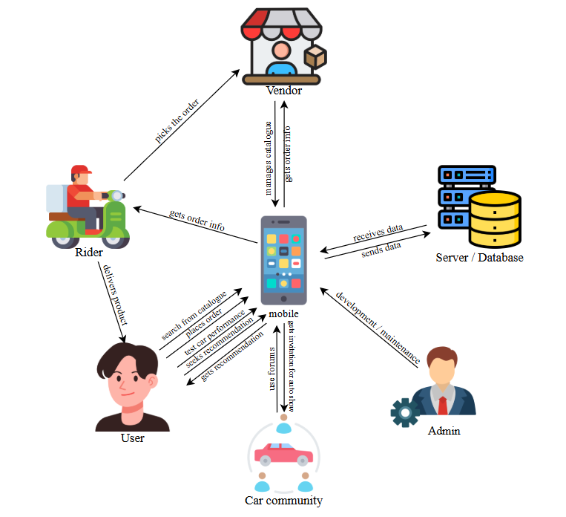
High Level System Diagram

Slide 14
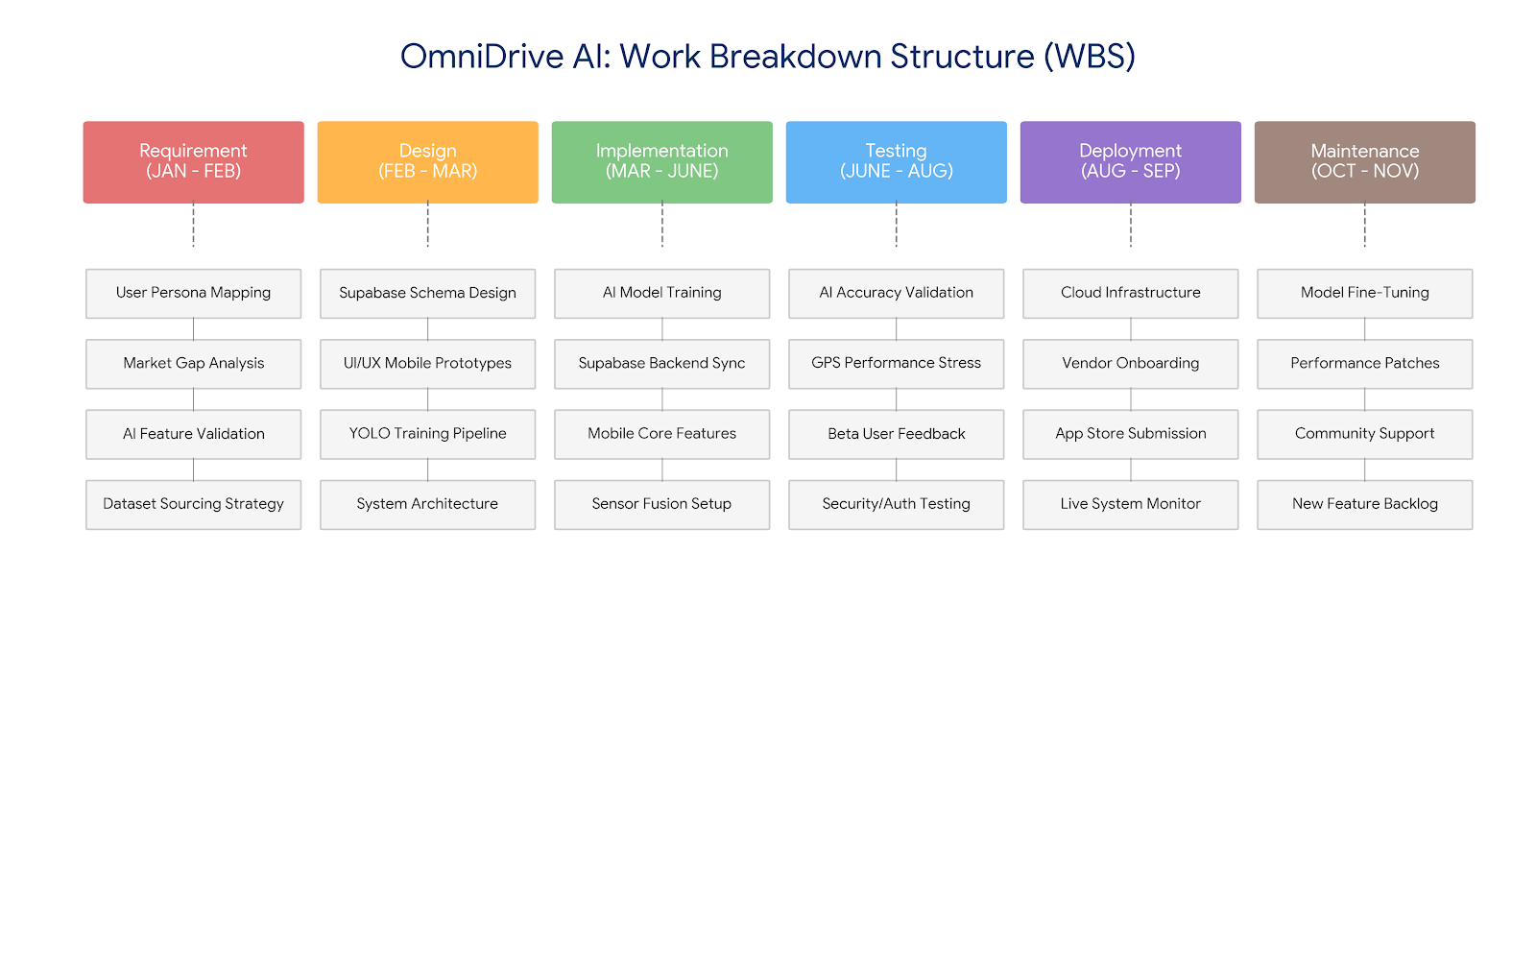
Work break down structure

Slide 15
Thank You!

